Slide 1

MACHINE DESIGN

Slide 2
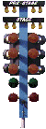

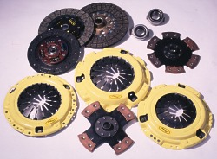
Clutches
GO

Slide 3
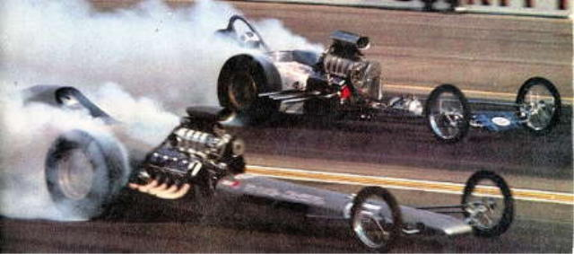
What is the purpose of the Clutch?

Slide 4
Purpose of the Clutch
Allows engine to be disengaged from transmission for shifting gears and coming to a stop
Allows smooth engagement of engine to transmission

Slide 5
Clutch classification
Clutches
Jaw clutches
Friction clutches
Hydraulic clutches
Plate clutches
Cone clutches
Centrifugal clutches
Single plate
Multi plate

Slide 6
Jaw Clutches
A clutch that consists of two mating surfaces with interconnecting elements, such as teeth, that lock together during engagement to prevent slipping.
These clutches are used to positively connect and disconnect rotating shafts where engagement and disengagement is not frequent.
Square jaws are used where engagement and disengagement under power or in motion is not required. They transmit power in both directions.
Spiral jaw are made in right or left hand style and will transmit power in only one direction. They can be engaged or disengaged at low speeds

Slide 7
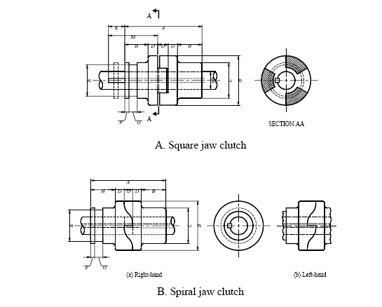
Jaw Clutches

Slide 8
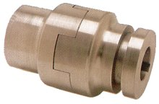
Jaw Clutches

Slide 9
Friction clutches
A mechanical clutch that transmits torque through surface friction between the faces of the clutch
Friction clutches have pairs of conical , disk, or ring-shaped mating surfaces and means for pressing the surfaces together. The pressure may be created by a spring or a series of levers locked in position by the wedging action of a conical spool.

Slide 10
Friction clutches

Slide 11
Friction clutches -Wet and dry clutches
A 'wet clutch' is immersed in a cooling lubricating fluid, which also keeps the surfaces clean and gives smoother performance and longer life. Wet clutches, however, tend to lose some energy to the liquid. A 'dry clutch', as the name implies, is not bathed in fluid. Since the surfaces of a wet clutch can be slippery (as with a motorcycle clutch bathed in engine oil), stacking multiple clutch disks can compensate for slippage.

Slide 12
Clutch construction
Basically, the clutch needs three parts. These are the engine flywheel, a friction disc called the clutch plate and a pressure plate. When the engine is running and the flywheel is rotating, the pressure plate also rotates as the pressure plate is attached to the flywheel. The friction disc is located between the two

Slide 13
Clutch construction

Slide 14
Clutch construction
Two basic types of clutch are the coil-spring clutch and the diaphragm-spring clutch. The difference between them is in the type of spring used. The coil spring clutch uses coil springs as pressure springs pressure. The diaphragm clutch uses a diaphragm spring.
The coil-spring clutch has a series of coil springs set in a circle.
At high rotational speeds, problems can arise with multi coil spring clutches owing to the effects of centrifugal forces both on the spring themselves and the lever of the release mechanism.
These problems are obviated when diaphragm type springs are used, and a number of other advantages are also experienced

Slide 15
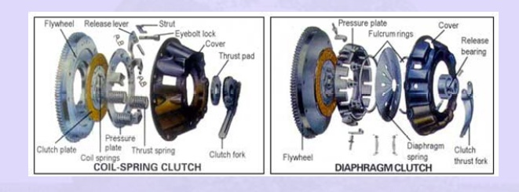
Clutch construction

Slide 16
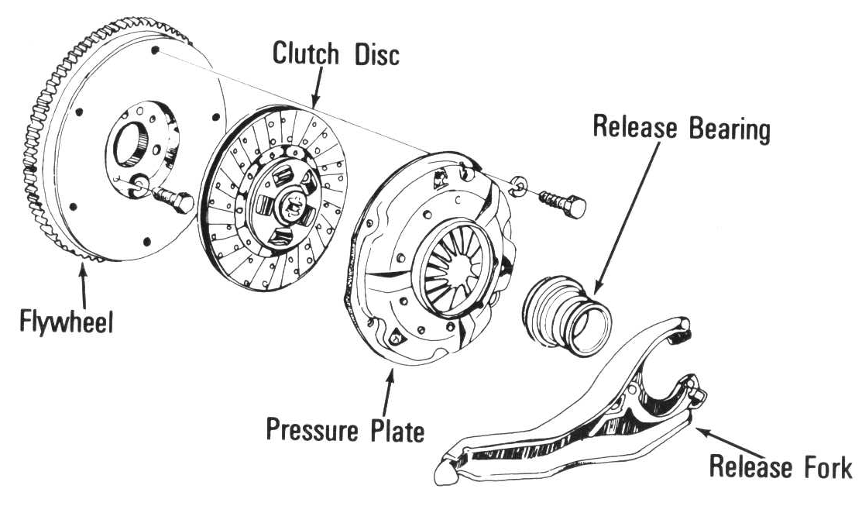
Clutch construction
Pilot bushing or bearing in center
of flywheel or crankshaft, supports
the end of input shaft
(friction disk) splined to transmission
Input shaft
(throw-out bearing
T/O bearing) allows
to push on rotating
clutch fingers
Bolted to Crank
Bolted to flywheel - Applies
the spring force to clamp the
friction disk to the flywheel
(clutch fork) pushes
T/O bearing to release
rotating clutch

Slide 17
Clutch operation
When the driver has pushed down the clutch pedal the clutch is released. This action forces the pressure plate to move away from the friction disc. There are now air gaps between the flywheel and the friction disc, and between the friction disc and the pressure plate. No power can be transmitted through the clutch
When the driver releases the clutch pedal, power can flow through the clutch. Springs in the clutch force the pressure plate against the friction disc. This action clamps the friction disk tightly between the flywheel and the pressure plate. Now, the pressure plate and friction disc rotate with the flywheel.

Slide 18
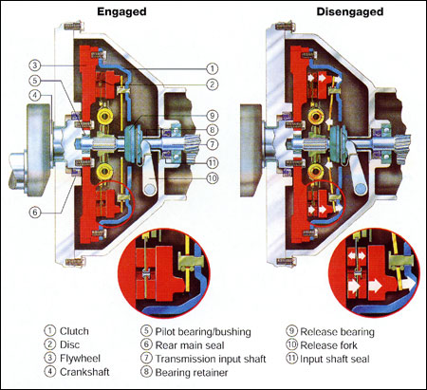
Clutch System

Slide 19
Single-plate Friction Clutch (Disengaged position)‏
Friction plate
springs
F_{a}
F_{a} (axial thrust)‏
Driving shaft
T
T
Driven shaft
Pressure plates
Friction lining

Slide 20
Single-plate Friction Clutch (Engaged position)‏
Friction plate
springs
F_{a}
F_{a}(axial thrust)‏
Driving shaft
T
T
Driven shaft
Pressure plates
Friction lining

Slide 23
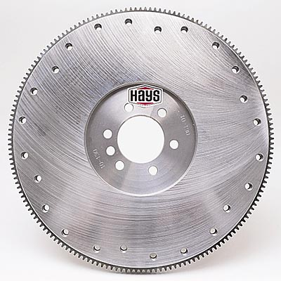
Flywheel

Slide 24
Flywheel
Acts as engine balancer
Works with crank balancer to smooth out firing pulses
Some will be balanced to engine
Adds inertia to engine rotation
Works as heat sink for clutch
Ring gear for starter engagement

Slide 25
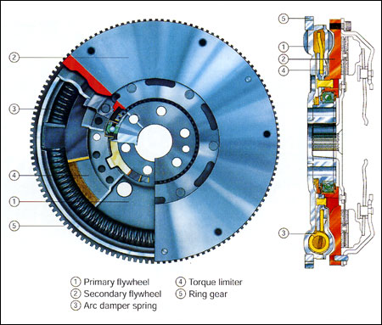
Dual mass flywheel

Slide 26
Dual mass flywheel
A dual-mass flywheel is split into two sections: a primary section that bolts to the crankshaft, and a secondary section, onto which the clutch is bolted.
The primary section of the flywheel contains springs to isolate engine vibrations and a torque limiter to prevent engine torque spikes from exceeding engine and transmission component strength.
When torque spikes occur, the torque limiter allows the primary section of the flywheel to turn independently of the secondary section, preventing damage to the driveline and transmission

Slide 27
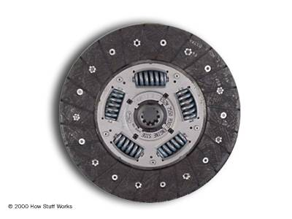
Torsional springs
Friction lining
Splined boss (hub)‏
Clutch Plate or Friction Plate

Slide 28
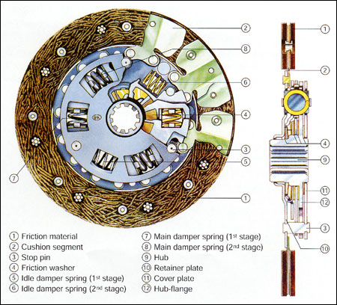
Clutch Plate or Friction Plate

Slide 29
Clutch disc
Friction material disc splined to input shaft
Friction material may contain ASBESTOS
Friction material can be bonded or riveted
Friction is attached to wave springs
Most have torsional dampener springs
Normal wearing component
Normally a worn out disc will cause slipping

Slide 30
Friction lining materials

Slide 31
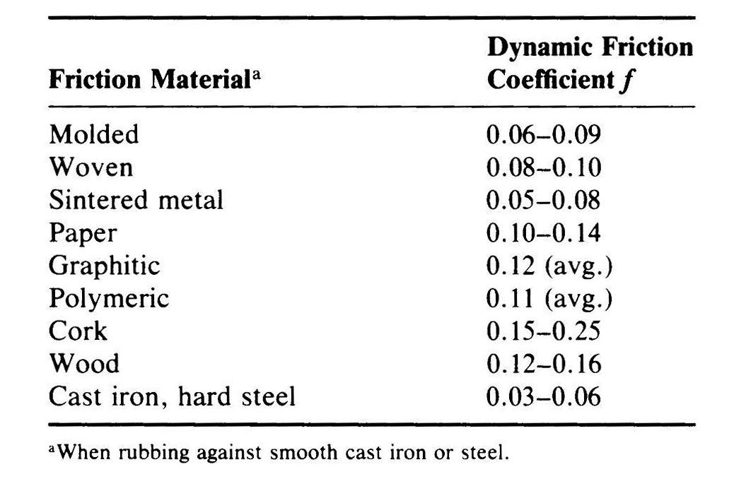
For wet condition

Slide 32
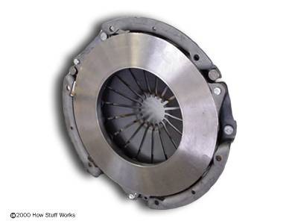
Clutch housing
Diaphragm spring
Pressure plate

Slide 33
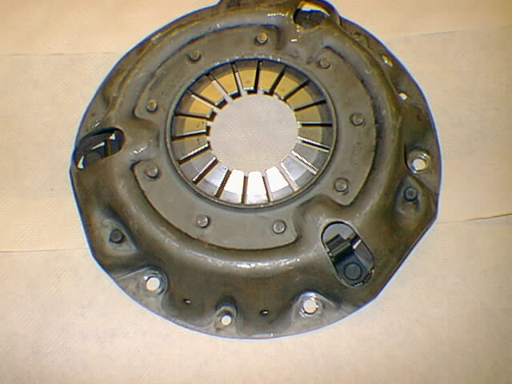
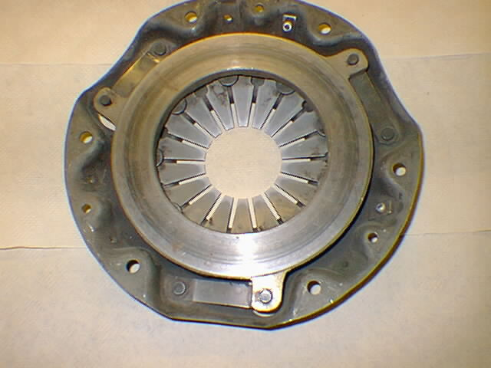
Pressure plate

Slide 34
Pressure plate
Provides clamping pressure to disc
Works like spring loaded clamp
Bolted to flywheel
Can use Belleville spring acted on by Throw Out bearing
Can use coil springs and levers acted on by Throw Out bearing

Slide 35
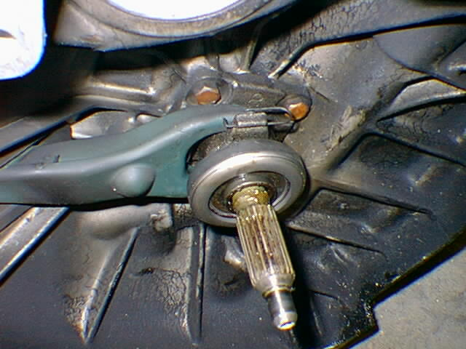
Release/ throw out bearing

Slide 36
Release/ throw out bearing
Acted on by clutch fork - acting on pressure plate
Moves toward flywheel when pedal pushed
Slides on front portion of transmission called bearing retainer
Normally not in contact with pressure plate until pedal pushed

Slide 37
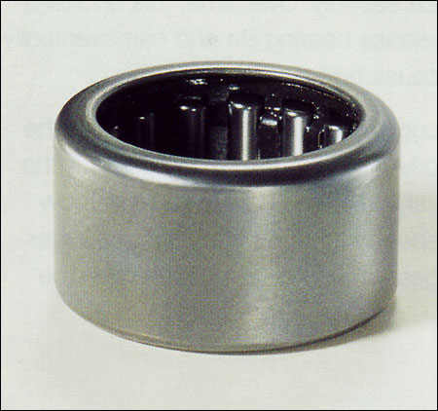
Pilot bearing / bushing

Slide 38
Pilot bearing / bushing
Used on some cars
Supports front of transmission input shaft
Can be needle bearing or bronze bushing
May be part of clutch kit

Slide 39
Clutch linkage
Can be operated by cable, rods or hydraulics
May be automatic or manually adjusted
Hydraulic will have a master and slave cylinder
Will use brake fluid for hydraulic action
Will need bleeding with repairs

Slide 40
Multiple plate clutch
In the case of a single plate clutch, bigger fly wheels and clutch plates are used to transmit torque. But in the case of multiple plate clutch, the frictional area is increased by the use of more number of smaller clutch discs. The pressure plates and clutch discs are alternately arranged on the spline shaft .The plates and the shaft are then assembled in a housing having splined hole.

Slide 41
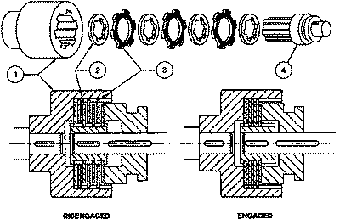
Multiple plate clutch
1. Housing 2. Pressure plates 3. Clutch disc 4. Spline shaft

Slide 42
Multiple plate clutch
Pressure plates
1
2
3
4
5
6
driver
driven
Friction plates
No. of driving pairs n = 6

Slide 43
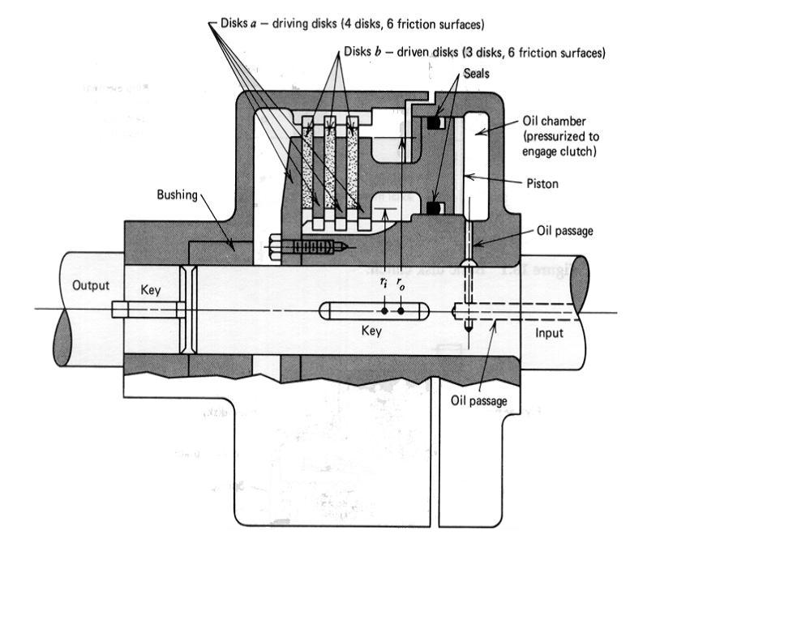
Multiple plate clutch

Slide 44
Multiple plate wet clutch

Slide 45
Design Analysis of Friction clutches
To design analyze the performance of these devices, a knowledge on the following are required.
1. The torque transmitted
2. The actuating force.
3. The energy loss
4. The temperature rise

Slide 46
Method of Analysis
Uniform Pressure Conditions
The torque that can be transmitted by a clutch is a function of its geometry and the magnitude of the actuating force applied as well as the condition of contact prevailing between the members. The applied force can keep the members together with a uniform pressure all over its contact area and the consequent analysis is based on uniform pressure condition

Slide 47
Method of Analysis
Uniform Wear Conditions
However as the time progresses some wear takes place between the contacting members and this may alter or vary the contact pressure appropriately and uniform pressure condition may no longer prevail. Hence the analysis here is based on uniform wear condition

Slide 48
Method of Analysis

Slide 49
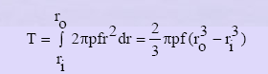
Method of Analysis
Assuming uniform pressure, p, the torque transmission capacity, T is given by,
f= coefficient of friction

Slide 50
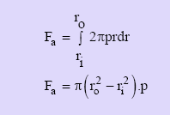
Uniform pressure condition
The actuating force,F_{a} that need to be applied to transmit this torque is given by,

Slide 51
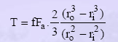
Uniform pressure condition
The above equations can be combined together to give equation for the torque as

Slide 52
Uniform pressure condition
Again, the equation of torque can be written as,
T = ½ f F_{a} D_{m}
D_{m} = mean diameter
= 2/3 [(D_{o}³ - D_{i}³)/ (D_{o}² – D_{i}²)]

Slide 53
Uniform pressure condition
In a plate clutch, the torque is transmitted by friction between one (single plate clutch) or more (multiple plate clutch) pairs of co-axial annular driving faces maintained in contact by an axial thrust.
If both sides of the plate are faced with friction material, so that a single-plate clutch has two pairs of driving faces in contact.
Then, for a plate clutch, the maximum torque transmitted is
T = ½ n’ f F_{a} D_{m}
n’ = no. of pairs of driving faces

Slide 54
Uniform wear condition
According to some established theories the wear in a mechanical system is proportional to the ‘pv’ factor where p refers the contact pressure and v the sliding velocity. Based on this for the case of a plate clutch we can state
constant-wear rate R_{w} =pv =constant

Slide 55
Uniform wear condition
putting, velocity, v =rω
R_{w} = prω = constant
Assuming a constant angular velocity
pr =constant
The largest pressure p_{max} must then occur at the smallest radius r_{i}
P_{max}r_{i} =constant
Hence pressure at any point in the contact region

Slide 56
Uniform wear condition
The axial force Fa is given by,
The torque transmission capacity is given by,

Slide 57
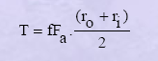
Uniform wear condition
Combining the two equations, we get
Torque

Slide 58
Uniform wear condition
Again, torque equation can be written as T =1/2 f F_{a} D_{m} where,
mean diameter D_{m} = (D_{o} + D_{i})/2.
If the clutch system have n’ pairs of friction surfaces, then torque,
T =1/2 n’ f F_{a} D_{m}

Slide 59
Design Torque
The design torque is given by
T_{d} = β T
where β is the engagement factor or the friction margin factor. It accounts for any slippage during transmission.
T =Torque to be transmitted

Slide 60
Power transmitted
The power transmitting capacity of the clutch system is given by,
P = 2пNT/60x1000 kW
N = speed in rpm
T = Torque transmitted

Slide 61
Cone clutch
A cone clutch serves the same purpose as a disk or plate clutch. However, instead of mating two spinning disks, the cone clutch uses two conical surfaces to transmit friction and torque. The cone clutch transfers a higher torque than plate or disk clutches of the same size due to the wedging action and increased surface area.

Slide 62
Cone clutch
Cone clutches are generally now only used in low peripheral speed applications although they were once common in automobiles and other combustion engine transmissions. They are usually now confined to very specialist transmissions in racing, rallying, or in extreme off-road vehicles, although they are common in power boats.

Slide 63
Cone-clutch
α = semi-apex angle of the cone
Only one pair of driving surfaces is possible, n =1
α
F_{a}
Driven shaft
D_{i}
D_{o}
F_{a}
Driving shaft
b
Friction lining
b=face width

Slide 64
Cone-clutch
F_{a}
F_{n} = Normal force
F_{n}
Friction force, F_{b} = f F_{n}
Axial force, F_{a} = F_{n} Sin α
α

Slide 65
Cone-clutch
If the clutch is engaged when one member is stationary and the other is rotating, there is force resisting engagement, and
F_{a}= F_{n} (sin α + f cos α)‏

Slide 66
Cone-clutch
The width of a cone face may be determined using the relation
F_{n} = π D_{m} b p
The dimensions of a cone clutch can be taken empirically as
D_{m}/b = 4.5 to 8
D_{m} = 5D to 10D where D =shaft diameter

Slide 67
Design of cone clutches
The torque transmission capacity of the cone clutch is,
T = F_{b} D_{m} /2
T = ½ f F_{a} D_{m} /Sin α where
D_{m} = mean diameter= (D_{o} + D_{i})/2.
α = semi apex angle of the cone

Slide 68
Centrifugal clutch
A centrifugal clutch works on the principle of centrifugal force.
The clutch's purpose is to disengage when the engine is idling so that the chain does not move .
These clutches are particularly useful in internal combustion engines, which can not be started under load.

Slide 69
Centrifugal clutch
The clutch consists of three parts:
An outer drum that turns freely - This drum includes a sprocket that engages the chain. When the drum turns, the chain turns.
A center shaft attached directly to the engine's crankshaft - If the engine is turning, so is the shaft.
A pair of cylindrical clutch weights attached to the center shaft, along with a spring that keeps them retracted against the shaft

Slide 70
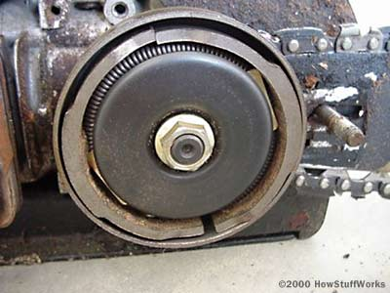
Centrifugal clutch

Slide 71
F_{c} = mrω²
Centrifugal clutch
Driven shaft
ω
Driving shaft
ω
Friction lining
.

Slide 72
Centrifugal clutch
There are several advantages to a centrifugal clutch
It is automatic. (In a car with a manual transmission, you need a clutch pedal. A centrifugal clutch doesn't.)
It slips automatically to avoid stalling the engine. (In a car, the driver must slip the clutch.)
Once the engine is spinning fast enough, there is no slip in the clutch.
It lasts forever.

Slide 73
Centrifugal clutch
Forces on the clutch shoe
In the running condition, the net radial force on the shoe is given as
F=F_{c}-F_{s} where,
F_{c} = centrifugal force = m r ω²
m = mass of each shoe, r = radius of gyration of the mass, ω = running speed
F_{s} = Spring force

Slide 74
Centrifugal clutch
The Spring force may be evaluated by putting
F = 0 , when ω is the angular speed at which the engagement starts.
The force of friction on a single shoe,
F_{f} =f F
f = coefficient of friction

Slide 75
Centrifugal clutch
The torque transmitting capacity of the clutch is given by
T = n F_{f} R
where R =radius of the drum,
n= number of shoes

Slide 76
Hydraulic clutches
The term 'hydraulic clutch' denotes a clutch which utilizes the forces of gravity of a liquid for the transmission of power.
Depressing the clutch pedal creates pressure in the clutch master cylinder, actuating the slave cylinder which, in turn, moves the release arm and disengages the clutch
Hydraulic types of clutch operating systems are found in heavy construction equipments where extreme pressures are required for clutch operation.

Slide 77
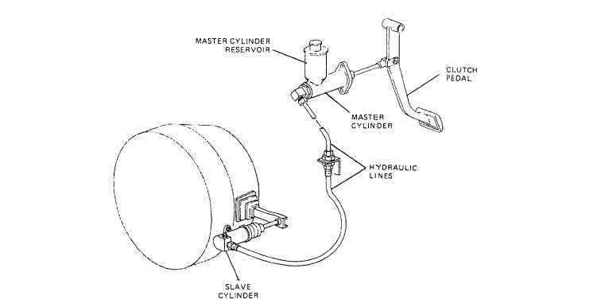
Hydraulic clutches

Slide 78
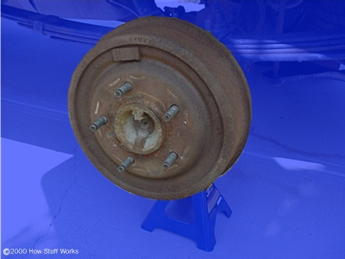
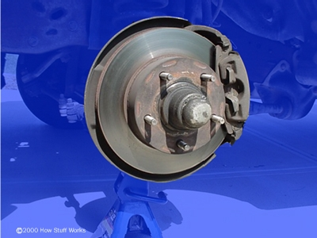
Brakes
GO

Slide 79
What is the purpose of the brake?

Slide 80
BRAKES
A brake is a device by means of which artificial resistance is applied on to a moving machine member in order to retard or stop the motion of the member or machine

Slide 81
BRAKES
Types of Brakes
Based on the working principle used brakes can be classified as mechanical brakes, hydraulic brakes, electrical (eddy current) magnetic and electro-magnetic types.

Slide 82
MECHANICAL BRAKES
Mechanical brakes are invariably based on the frictional resistance principles• In mechanical brakes artificial resistances created using frictional contact between the moving member and a stationary member, to retard or stop the motion of the moving member.

Slide 83
Types of Brakes
According to the direction of acting force
Radial brakes
Axial brakes
Axial brakes include disc brakes and cone brakes

Slide 84
Types of Brakes
Depending upon the shape of the friction elements, radial brakes may be named as
i. Drum or Shoe brakes
ii. Band brakes
Many cars have drum brakes on the rear wheels and disc brakes on the front

Slide 85
Disc brakes

Slide 86
Drum brake

Slide 87
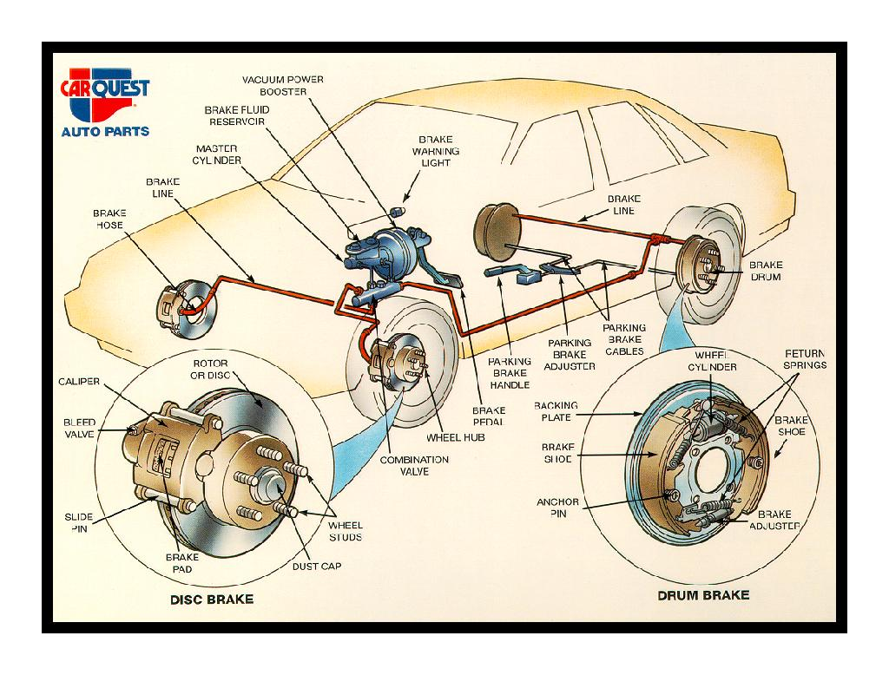

Slide 88
Drum Brakes
Drum brakes work on the same principle as disc brakes: Shoes press against a spinning surface. In this system, that surface is called a drum.

Slide 89
Shoe Brakes
Drum Brakes are classified based on the shoe geometry.
Shoes are classified as being either short or long.
The shoes are either rigid or pivoted, pivoted shoes are also some times known as hinged shoes

Slide 90
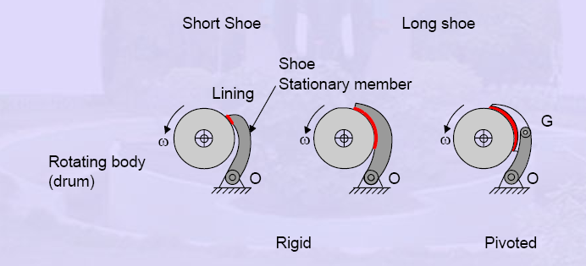
Shoe Brakes

Slide 91
Design and Analysis
To design, select or analyze the performance of these devices knowledge on the following are required.
The braking torque
The actuating force needed
The energy loss and temperature rise

Slide 92
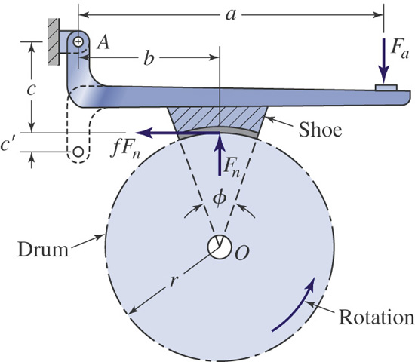
Short-Shoe Drum Brakes
If the shoe is short (less than 45º contact angle), a uniform pressure distribution may be assumed which simplifies the analysis in comparison to long-shoe brakes.

Slide 93
Shoe Brakes Analysis
On the application of an actuating force F_{a}, a normal force F_{n} is created when the shoe contacts the rotating drum. And a frictional force F_{f} of magnitude f.F_{n} , f being the coefficient of friction, develops between the shoe and the drum.

Slide 94
Shoe Brakes
Analysis

Slide 95
Short shoe analysis
Moment of this frictional force about the drum center constitutes the braking torque.
The torque on the brake drum is then,
T = f F_{n}. r = f.p.A.r

Slide 96
Short shoe analysis
Applying the equilibrium condition by taking moment about the pivot ‘O’ we can write
Substituting for F_{n} and solving for the actuating force, we get,

Slide 97
Short shoe analysis

Slide 98
With the shown direction of the drum rotation (CCW), the moment of the frictional force f. F_{n} c adds to the moment of the actuating force, F_{a}
As a consequence, the required actuation force needed to create a known contact pressure p is much smaller than that if this effect is not present. This phenomenon of frictional force aiding the brake actuation is referred to as self-energization.

Slide 99
Leading and trailing shoe
For a given direction of rotation the shoe in which self energization is present is known as the leading shoe
When the direction of rotation is changed, the moment of frictional force now will be opposing the actuation force and hence greater magnitude of force is needed to create the same contact pressure. The shoe on which self energization is not present is known as a trailing shoe

Slide 100
Self Locking
At certain critical value of f.c the term (b-fc) becomes zero. i.e no actuation force need to be applied for braking. This is the condition for self-locking. Self-locking will not occur unless it is specifically desired.

Slide 101
Self-Energizing & Self-Locking Brakes
If the rotation is as shown, then
F_{a} = (F_{n}/a)(b – fc).
If b <= fc, then the brake is self-locking.
Think of a door stop, that is a self-locking short shoe brake.

Slide 102
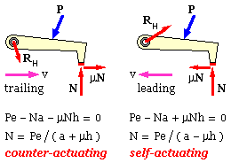
Self-Energizing & Self-Locking Brakes

Slide 103
Brake with a pivoted long shoe
When the shoe is rigidly fixed to the lever, the tendency of the frictional force (f.Fn) is to unseat the block with respect to the lever. This is eliminated in the case of pivoted or hinged shoe brake since the braking force acts through a point which is coincident
with the brake shoe pivot.

Slide 104
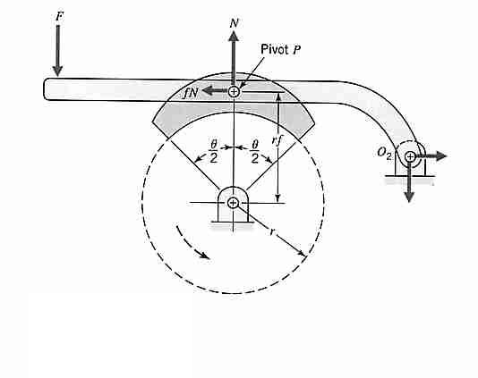
Pivoted-shoe brake

Slide 105
Pivoted-shoe brake
The distance of the pivot from the drum centre
Torque transmitted is given by
T = f F_{N} r_{f}

Slide 106
DOUBLE BRAKE PIVOTED SHOE

Slide 107
In reality constant or uniform constant pressure may not prevail at all points of contact on the shoe.
• In such case the following general procedure of analysis can be adopted

Slide 108
General Analysis
Estimate or determine the distribution of pressure on the frictional surfaces
Find the relation between the maximum pressure and the pressure at any point
For the given geometry, apply the condition of static equilibrium to find the actuating force, torque and reactions on support pins etc.

Slide 109
DRUM BRAKES
Drum brakes” of the following types are mainly used in automotive vehicles and cranes and elevators.
• Rim types with internal expanding shoes
• Rim types with external contracting shoes

Slide 110
Internal expanding Shoe
The rim type internal expanding shoe is widely used for braking systems in automotive applications and is generally referred as internal shoe drum brake. The basic approach applied for its analysis is known as long-rigid shoe brake analysis.

Slide 111
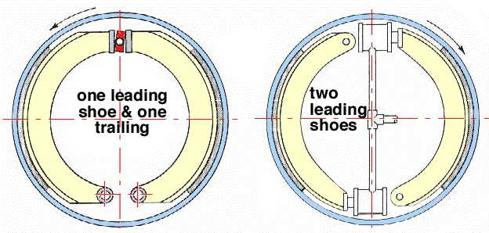
Internal expanding Shoe

Slide 112
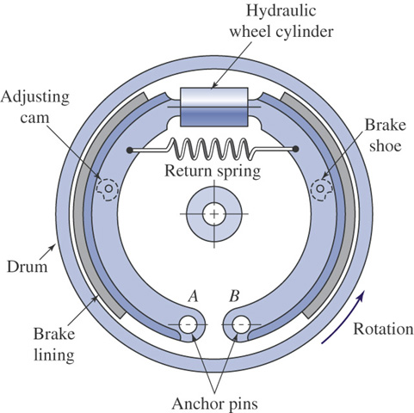
Internal Long-Shoe Drum Brakes
Formerly in wide automotive use; being replaced by caliper disc brakes, which offer better cooling capacity (and many other advantages).

Slide 113
Internal Long-Shoe Drum Brakes

Slide 114
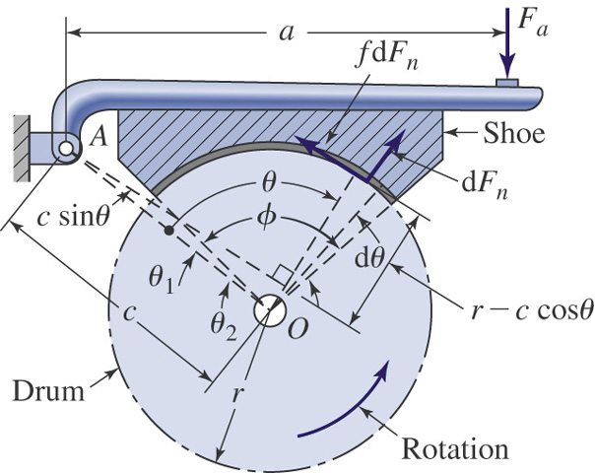
Long-Shoe Drum Brakes
Cannot assume uniform pressure distribution, so the analysis is more involved.

Slide 115
LONG RIGID SHOE ANALYSIS
In this analysis, the pressure at any point is assumed to be proportional to the vertical distance from the hinge pin, the vertical distance from the hinge pin, which in this case is proportional to sine of the angle and thus,
Since the distance d is constant, the normal pressure at any point is just proportional to sinΘ. Call this constant of proportionality as K

Slide 116
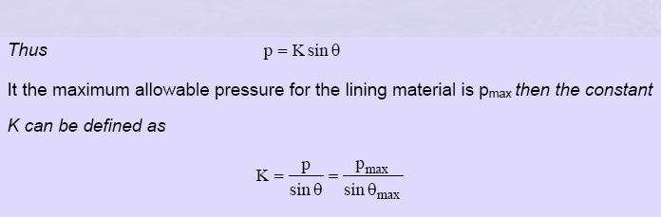
LONG RIGID SHOE ANALYSIS

Slide 117
LONG RIGID SHOE ANALYSIS
The actuating force F is determined by the summation of the moments of normal and frictional forces about the hinge pin and equating it to zero.
Summing the moment about point O gives

Slide 118
LONG RIGID SHOE ANALYSIS
where,
M_{n} and M_{f} are the moment of the normal and frictional forces respectively, about the shoe pivot point.
The sign depends upon the direction of drum rotation,
- sign for self energizing and + sign for non self energizing

Slide 119
LONG RIGID SHOE ANALYSIS
Moment of the normal force

Slide 120
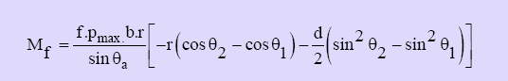
LONG RIGID SHOE ANALYSIS
the moment of friction force

Slide 121
LONG RIGID SHOE ANALYSIS
The braking torque T on the drum by the shoe is

Slide 122
Double Shoe Brakes
Two Shoes are used to cover maximum area and to minimize the unbalanced forces on the drum, shaft and bearings.

Slide 123
Double Shoe Brakes
If both the shoes are arranged such that both are leading shoes in which self energizing are prevailing, then all the other parameters will remain same and the total braking torque on the drum will be twice the value obtained in the analysis.

Slide 124
Double Shoe Brakes
However in most practical applications the shoes are arranged such that one will be leading and the other will be trailing for a given direction of drum rotation
• If the direction of drum rotation changes then the leading shoe will become trailing and vice versa.

Slide 125
Double Shoe Brakes- one leading &one trailing
Thus this type of arrangement will be equally effective for either direction of drum rotation
Further the shoes can be operated upon using a single cam or hydraulic cylinder thus provide for ease of operation

Slide 126
Double Shoe Brakes- one leading &one trailing
However the total braking torque will not be the twice the value of a single shoe,
This is because the effective contact pressure (force) on the trailing shoe will not be the same, as the moment of the friction force opposes the normal force, there by reducing its actual value as in most applications the same normal force is applied or created at the point of force application on the brake shoe as noted above

Slide 127
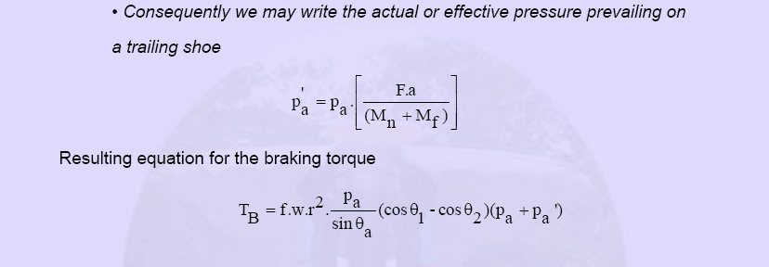
Double Shoe Brakes- one leading &one trailing

Slide 129
External Contracting Rigid Shoes
These are external rigid shoe brakes - rigid because the shoes with attached linings are rigidly connected to the pivoted posts; external because they lie outside the rotating drum. An actuation linkage distributes the actuation force to the posts thereby causing them both to rotate towards the drum - the linings thus contract around the drum and develop a friction braking torque.

Slide 130
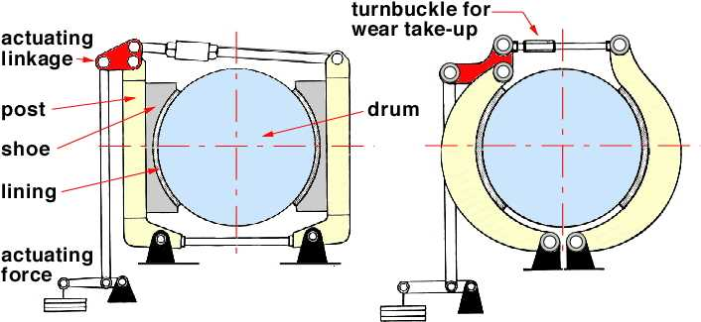
External Contracting Rigid Shoes

Slide 131
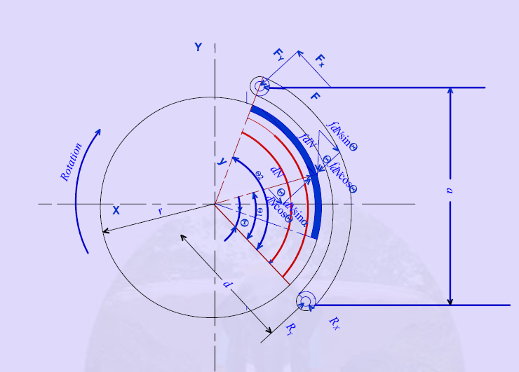
External Contracting Rigid Shoes

Slide 132
External Contracting Rigid Shoes
The resulting equations for moment of normal and frictional force as well as the actuating force and braking torque are same as seen earlier.
As noted earlier for the internal expanding shoes, for the double shoe brake the braking torque for one leading and one trailing shoe acted upon a common cam or actuating force the torque equation developed earlier can be applied

Slide 133
Band Brakes
A band brake consists of a flexible band faced with friction material bearing on the periphery of a drum which may rotate in either direction.
The actuation force P is applied to the band's extremities through an actuation linkage such as the cranked lever illustrated. Tension build-up in the band is identical to that in a stationary flat belt.

Slide 134
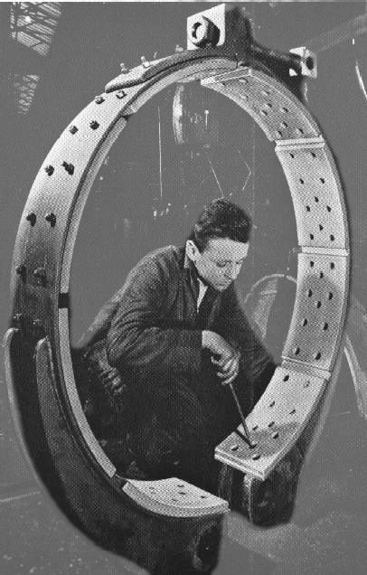
Band Brakes
The band cross-section shows lining material riveted to the band.

Slide 135
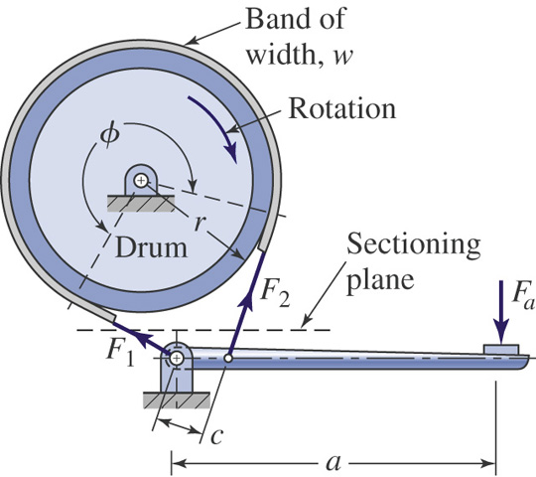
Simple Band Brake
For a simple band brake one end of the band is always connected to the fulcrum.
Very similar to a belt drive; torque capacity is T = (F1 – F2)r

Slide 136
Simple Band Brake
For the cw rotation of the drum the tensions in the tight side (F₁) and slack side (F₂) are related by
F₁/F₂ = e^{fθ} ,
where
f = coefficient of friction
θ = Angle of contact

Slide 137
Simple Band Brake
For the simple band brake arrangement as shown above, the actuating force F_{a} is given as,
F_{a}= c F₂ / a
If the direction of rotation is changed to ccw, then the tight and slack sides are reversed. Therefore the actuating force is
F_{a} = c F₁ / a

Slide 138
Simple Band Brake
Since the tension in the band is not a constant,
the pressure is a maximum at the tight side and
a minimum at the slack side, so
p_{max} = F₁/ w r ,
p_{min} = F₂ / w r,
where w= width of the band

Slide 139
Simple Band Brake
The band thickness is given empirically as
h =0.005D, D=drum diameter
The width of the band w = F₁ / h σ_{d} ,
, σ_{d} = design stress of the band material

Slide 140
Differential Band Brake
For the differential band brakes, neither ends of the band are connected to the fulcrum.
The differential band brake as shown below can be configured to be self energizing and can be arranged to operate in either direction.
The friction force is F₁-F₂ and it acts in the direction of F₁, and therefore a band brake will be self energizing when F₁ acts to apply the brake as shown below.

Slide 141
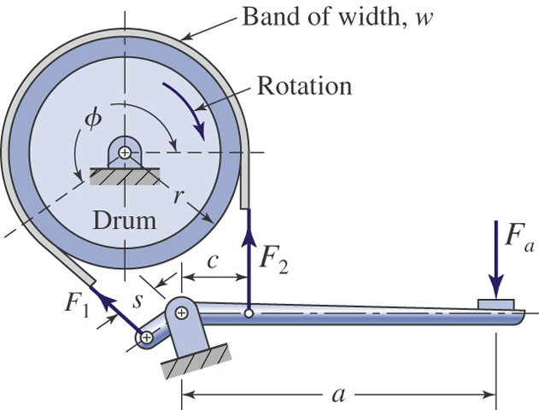
Differential Band Brake
The friction force helps to apply the band: therefore it is “self-energizing.”

Slide 142
Differential Band Brake
The equation for the actuating force is obtained by summing the moments about the pivot point. Thus,
F_{a} a + F₁ s –F₂ c = 0
F_{a} = (F₂ c –F₁ s) / a
If F₂ c < F₁ s , the actuating force will be negative or zero as the case may be and the brake is called as self-locking.
It is also apparent that the brake is effectively free wheeling in the opposite direction. The differential brake can therefore be arranged to enable rotation in one direction only.

Slide 143
Belt Drives
Belt drives are called flexible machine elements.
Used in conveying systems
Used for transmission of power.
Replacement of rigid type power transmission system.

Slide 144
Open Belt Drive

Slide 145
Open Belt Drive

Slide 146
Cross Belt drive

Slide 147
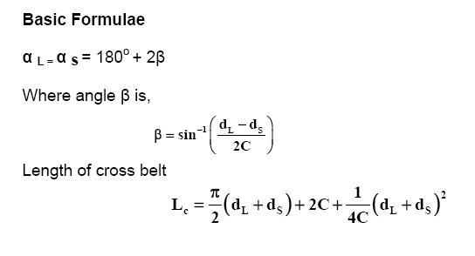
Cross Belt Drive

Slide 148
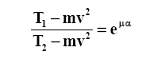
Relationship between belt tensions
The equation for determination of relationship between belt tensions is

Slide 149
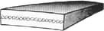
Belt types
Flat belts made from joined hides were first on the scene, however modern flat belts are of composite construction with cord reinforcement. They are particularly suitable for high speeds.

Slide 150
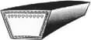
Belt types
Classical banded ( ie. covered ) V-belts comprise cord tensile members located at the pitchline, embedded in a relatively soft matrix which is encased in a wear resistant cover. The wedging action of a V-belt in a pulley groove results in a drive which is more compact than a flat belt drive, but short centre V-belt drives are not conducive to shock absorption

Slide 151
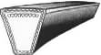
Belt types
Wedge belts are narrower and thus lighter than V-belts. Centrifugal effects which reduce belt-pulley contact pressure and hence frictional torque are therefore not so deleterious in wedge belt drives as they are in V-belt drives.

Slide 152
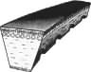
Belt types
Modern materials allow cut belts to dispense with a separate cover. The belt illustrated also incorporates slots on the underside known as cogging which alleviate deleterious bending stresses as the belt is forced to conform to pulley curvature.

Slide 153

Belt types
Synchronous or timing belt drives are positive rather than friction drives as they rely on gear- like teeth on pulley and belt enabled by modern materials and manufacturing methods

Slide 154
Timing Belts
Toothed or synchronous belts don’t slip, and therefore transmit torque at a constant ratio: great for applications requiring precise timing, such as driving an automotive camshaft from the crankshaft.
Very efficient. More $ than other types of belts.

Slide 155

Timing Belts

Slide 156
Flat, Round, and V Belts
Flat and round belts work very well. Flat belts must work under higher tension than V belts to transmit the same torque as V belts. Therefore they require more rigid shafts, larger bearings, and so on.
V belts create greater friction by wedging into the groove on the pulley or sheave. This greater friction = great torque capacity.

Slide 157

V Belt & Sheave Cross Section
The included angle 2β ranges between 34º and 40º.

Slide 158

V Belt Cross Sections (U.S.)‏

Slide 159
Flat Belts vs. V Belts
Flat belt drives can have an efficiency close to 98%, about the same as a gear drive.
V belt drive efficiency varies between 70% and 96%, but they can transmit more power for a similar size. (Think of the wedged belt having to come un-wedged.)‏
In low power applications (most industrial uses), the cheaper installed cost wins vs. their greater efficiency: V belts are very common.

Slide 160

Flat Belt Drives
Flat belts drives can be used for large amount of power transmission and there is no upper limit of distance between the two pulleys.
Idler pulleys are used to guide a flat belt in various manners, but do not contribute to power transmission
These drives are efficient at high speeds and they offer quite running.

Slide 161
Belt Materials
The belt material is chosen depending on the use and application. Leather oak tanned belts and rubber belts are the most commonly used but the plastic belts have a very good strength almost twice the strength of leather belt. Fabric belts are used for temporary or short period operations.

Slide 162
Typical Belt Drive Specifications
Belts are specified on the following parameters
Material
No of ply and thickness
Maximum belt stress per unit width
Density of the belt material
Coefficient of friction of the belt material

Slide 163
Design Factors
A belt drive is designed based on the design power, which is the modified required power. The modification factor is called the service factor. The service factor depends on hours of running, type of shock load expected and nature of duty.
Hence,
Design Power (P_{d}) = service factor (C_{s})* Required Power (P)‏
C_{s} = 1.1 to 1.8 for light to heavy shock.

Slide 164
Design Factors
Speed correction factor(C_{S})- When Maximum belt stress/ unit width is given for a specified speed, a speed correction factor ( C_{S} ) is required to modify the belt stress when the drive is operating at a speed other than the specified one.
Angle of wrap correction factor(C_{W})-The maximum stress values are given for an angle of wrap is 180^{ο} for both the pulleys, ie, pulleys are of same diameter. Reduction of belt stress is to be considered for angle of wrap less than 180^{ο}.

Slide 165
Design Factors
From the basic equations for belt drive, it can be shown that,
P_{d} =
where σ’ = σ_{max} C_{S} C_{w}

Slide 166
Selection of Flat Belt
Transmission ratio of flat belt drives is normally limited to 1:5
Centre distance is dependent on the available space. In the case of flat belt drives there is not much limitation of centre distance. Generally the centre distance is taken as more than twice the sum of the pulley diameters.
Depending on the driving and driven shaft speeds, pulley diameters are to be calculated and selected from available standard sizes.
Belt speed is recommended to be within 15-25 m/s.
Finally, the calculated belt length is normally kept 1% short to account for correct initial tension.

Slide 167
Nomenclature of V-Belts

Slide 168
Standard V-Belt Sections
The standard V-belt sections are A, B, C, D and E.
The table below contains design parameters for all the sections of V-belt

Slide 169
Belt Section Selection
Belt section selection depends solely on the power transmission required, irrespective of number of belts.
If the required power transmission falls in the overlapping zone, then one has to justify the selection from the economic view point also.
In general, it is better to choose that section for which the required power transmission falls in the lower side of the given range.
Another restriction of choice of belt section arises from the view point of minimum pulley diameter.
If a belt of higher thickness (higher section) is used with a relatively smaller pulley, then the bending stress on the belt will increase, thereby shortening the belt life.

Slide 170

V-Belt Designation
V-belts are designated with nominal inside length (this is easily measurable compared to pitch length).
Inside length + X=Pitch Length
A B- section belt with nominal inside length of 1016 mm or 40 inches is designated as,

Slide 171
V-Belt Equation
V-belts have additional friction grip due to the presence of wedge. Therefore, modification is needed in the equation for belt tension. The equation is modified as,
Where θ is the belt wedge angle

Slide 172
V-Belt power rating
Each type of belt section has a power rating. The power rating is given for different pitch diameter of the pulley and different pulley speeds for an angle of wrap of 180⁰. A typical nature of the chart is shown below.

Slide 173
V-Belt design factors
Service factor-The service factor depends on hours of running, type of shock load expected and nature of duty.
Design Power (P_{D}) = service factor (C_{s} )* Required Power (P)
C_{s} = 1.1 to 1.8 for light to heavy shock.
The power rating of V-belt is estimated based on the equivalent smaller pulley diameter (d_{ES}).
d_{E} = C_{SR} d
C_{SR} depends on the speed ratio

Slide 174
V-Belt design factors
Angle of wrap correction factor-The power rating of V-belts are based on angle of wrap, α =180⁰ . Hence, Angle of wrap correction factor ( C_{vw} ) is incorporated when α is not equal to 180^{ο} .
Belt length correction factor -There is an optimum belt length for which the power rating of a V-belt is given. Depending upon the amount of flexing in the belt in a given time a belt length correction factor (C_{vL}) is used in modifying power rating.

Slide 175
Modified Power Rating
Therefore, incorporating the correction factors,
Modified power rating of a belt (kW )
= Power rating of a belt ( kW) x C_{vw} x C_{vl}

Slide 176
Selection of V-Belt
The transmission ratio of V belt drive is chosen within a range of 1:15
Depending on the power to be transmitted a convenient V-belt section is selected.
The belt speed of a V-belt drive should be around 20m/s to 25 m/s, but should not exceed 30 m/s.
From the speed ratio, and chosen belt speed, pulley diameters are to be selected from the standard sizes available.
Depending on available space the center distance is selected, however, as a guideline,
D < C < 3(D + d )

Slide 177

Selection of V-Belt
The belt pitch length can be calculated if C, d and D are known. Corresponding inside length then can be obtained from the given belt geometry. Nearest standard length, selected from the design table, is the required belt length.
The design power and modified power rating of a belt can be obtained using the equations. Then

Slide 178
Chains
Compared to belts, chains can transmit more power for a given size, and can maintain more precise speed ratios.
Like belts, chains may suffer from a shorter life than a gear drive. Flexibility is limited by the link-length, which can cause a non-uniform output at high speeds.

Slide 179
Types of chain drives
Roller chain - Roller chains are one of the most efficient and cost effective ways to transmit mechanical power between shafts. They operate over a wide range of speeds, handle large working loads, have very small energy losses, and are generally inexpensive compared with other methods of transmitting power between rotating shafts. Chain drives should ideally be lubricated and regularly cleaned . However experience shows that this drive method will work for long periods without lubrication or maintenance

Slide 180
Types of chain drives
Inverted tooth chain - Also called silent. Motion transferred via shaft mounted pinions (similar to gear wheels.) Higher power power capacities, higher speeds and smoother operation. These drive system definitely requires lubrication. (Oil bath, or spray.)
Leaf chain - These chains are used for lifting loads and do not involve tooth sprockets or gear wheels. They are used on fork lift trucks and machine tools

Slide 181
Roller chain
The roller chain is used to transmit motion between rotating shafts via sprockets mounted on the shafts.
Roller chains are generally manufactured from high specification steels and are therefore capable of transmitting high torques within compact space envelopes.
Compared to belt drives the chain drives can transmit higher powers and can be used for drives with larger shaft centre distance separations.

Slide 182

Chain Nomenclature

Slide 183

Chain Nomenclature

Slide 184

View with side plates omitted

Slide 185

Typical arrangement

Slide 186

Chain Types
Chains manufactured to British/ISO standards can be supplied as single strand (SIMPLEX), double strands (DUPLEX), or triple strands (TRIPLEX)..

Slide 187
Selection of Roller Chain
The following data should be taken into
consideration while selecting roller chain drives.
a. Horsepower to be transmitted
b. Speed ratio
c. Load classification
d. Space limitations if any
e. Driven machine
f. Source of power

Slide 188
Selection of Roller Chain
Determine the chain pitch using the equation,
pitch ‘
p’ in mm < 10[60.67/n₁]^{2/3}
n₁ = speed of smaller sprocket in rps
Select the chain type for the selected pitch
Select the number of teeth on the smaller sprocket for the given transmission ratio. Determine the corresponding number of teeth on the larger sprocket, and the chain velocity.
For ordinary applications the economical chain speed is 10 to 15 m/s.

Slide 189
Selection of Roller Chain
Calculate the allowable working load(F_{W}) for the selected chain using the relation,
F_{W} = F_{U} / F.S
F_{U} = Ultimate strength per strand
F.S = Factor of safety

Slide 190
Selection of Roller Chain
Tangential load (F) on the chain is determined using the relation
F = 1000 P/v
P =Transmitting power in kW
Design load, F_{d} =F C_{S}
C_{S} = Service factor
Minimum number of strand in the chain is given by, j =F_{d} /F_{W}

Slide 191
Selection of Roller Chain
Average chain velocity, v =pzn/1000
p=pitch (mm), z = number of teeth on the sprocket, n = speed in rps
Pitch diameters of the larger and smaller sprockets are determined using the relation, D or d = p/sin(180/z)

Slide 192
Selection of Roller Chain
An optimum centre distance is calculated using the relation,
C= 40p
The length of the chain in pitches is determined using the equation,
L_{P} = 2C_{P}+0.5(z₁+z₂)+0.026(z₂-z₁)²/C_{P}
C_{P} = center distance in pitches
Chain length , L = p L_{P}

Slide 193
Actual Factor of Safety
Actual factor of safety,
F.S = F_{U}/(F+F_{S}+F_{C})‏
F_{C} = Centrifugal tension =w’ v²/g
w’ = weight per unit length of the chain
F_{S} = tension due to sagging of chain=K₂w’C
K₂ = coefficient of sag

Slide 194
Check for wear
Induced bearing pressure on pin is
p_{b} = F_{d} k₁ /A
F_{d} = design load
k₁ = lubrication factor
= 1 for continuous lubrication
= 1.3 for periodic lubrication
A = projected pin area = D_{p} x l_{p} x strand factor

Slide 195
Module II
GEARS

Slide 196
GEARS
Gears are machine elements used to transmit rotary motion between two shafts, normally with a constant ratio.
In practice the action of gears in transmitting motion is a cam action, each pair of mating teeth acting as cams.
The smaller gear in a pair is often called the pinion; the larger, either the gear, or the wheel.

Slide 197
GEAR CLASSIFICATION
Gears may be classified according to the relative position of the axes of revolution
The axes may be
1.parallel,
2.intersecting,
3.neither parallel nor intersecting.

Slide 198
GEARS FOR CONNECTING PARALLEL SHAFTS
Spur gears
Parallel helical gears
Herringbone gears (or double-helical gears)
Rack and pinion (The rack is like a gear whose axis is at infinity.)

Slide 199
GEARS FOR CONNECTING INTERSECTING SHAFTS
Straight bevel gears
Spiral bevel gears

Slide 200
NEITHER PARALLEL NOR INTERSECTING SHAFTS
Crossed-helical gears
Hypoid gears
Worm and worm gear

Slide 201

SPUR GEAR PAIR

Slide 202

SPUR RACK AND PINION

Slide 203

HELICAL GEAR PAIR

Slide 204

HELICAL GEARS

Slide 205

HELICAL RACK AND PINION

Slide 206

ECCENTRIC SPUR GEAR PAIR

Slide 207

HERRINGBONE GEAR PAIR

Slide 208

DOUBLE HELICAL GEAR PAIR

Slide 209

SINGLE PLANETORY GEAR SET

Slide 210

INTERMITTENT SPUR GEAR PAIR

Slide 211

RIGHT ANGLE STRAIGHT BEVEL PAIR

Slide 212

RIGHT ANGLE STRAIGHT BEVEL PAIR

Slide 213

NON-RIGHT ANGLE STRAIGHT BEVEL PAIR

Slide 214

NON-RIGHT ANGLE STRAIGHT BEVEL PAIR

Slide 215

SPIRAL BEVEL GEAR PAIR

Slide 216

MITER GEAR

Slide 217

SPIRAL BEVEL GEAR PAIR

Slide 218

HYPOID BEVEL GEAR PAIR

Slide 219

RIGHT ANGLE WORM GEAR PAIR

Slide 220

NON-RIGHT ANGLE WORM GEAR PAIR

Slide 221

CROWN GEAR

Slide 222

INTERNAL GEAR

Slide 223

Internal Spur Gear System

Slide 224

GEAR NOMENCLATURE

Slide 225


Slide 226
TERMINOLOGY
Diametral pitch (P )...... The number of teeth per one inch of pitch circle diameter.
Module. (m) ...... The length, in mm, of the pitch circle diameter per tooth.
Circular pitch (p)...... The distance between adjacent teeth measured along the are at the pitch circle diameter
Addendum ( ha)...... The height of the tooth above the pitch circle diameter.

Slide 227
TERMINOLOGY
Centre distance (a)...... The distance between the axes of two gears in mesh.
Circular tooth thickness (t)...... The width of a tooth measured along the are at the pitch circle diameter.
Dedendum (hf )...... The depth of the tooth below the pitch circle diameter.

Slide 228
TERMINOLOGY
Outside diameter ( do )...... The outside diameter of the gear.
Base Circle diameter ( db ) ...... The diameter on which the involute teeth profile is based.
Pitch circle dia ( d) ...... The diameter of the pitch circle.
Pitch point...... The point at which the pitch circle diameters of two gears in mesh coincide.

Slide 229
TERMINOLOGY
Pitch to back...... The distance on a rack between the pitch circle diameter line and the rear face of the rack.
Pressure angle ( ) ...... The angle between the tooth profile at the pitch circle diameter and a radial line passing through the same point.
Whole depth(h)...... The total depth of the space between adjacent teeth.

Slide 230
LAW OF GEARING
AS THE GEAR ROTATE,THE COMMON NORMAL AT THE POINT OF CONTACT BETWEEN THE TEETH ALWAYS PASS THROUGH A FIXED POINT ON THE LINE OF CENTERS.THE FIXED POINT IS CALLED PITCH POINT.IF THE TWO GEARS IN MESH SATISFY THE BASIC LAW, THE GEARS ARE SAID TO PRODUCE CONJUGATE ACTION.

Slide 231
LAW OF GEARING
PITCH LINE VELOCITY, V = ω₁ r₁ = ω₂ r₂
SPEED RATIO,
r_{s=} ω₂/ω₁ = N₂/N₁ = Z₁/Z₂ = d₁/d₂
ω -angular velocity, N-speed, Z- no of teeth
d-pitch circle diameter

Slide 232

CONJUGATE ACTION
It is essential for correctly meshing gears, the size of the teeth ( the module ) must be the same for both the gears.
Another requirement - the shape of teeth necessary for the speed ratio to remain constant during an increment of rotation; this behavior of the contacting surfaces (ie. the teeth flanks) is known as conjugate action.

Slide 233

TOOTH PROFILES
Many tooth shapes are possible for which a mating tooth could be designed to satisfy the fundamental law, only two are in general use: the cycloidal and involute profiles.
Modern gearing (except for clock gears) is based on involute teeth.

Slide 234
TOOTH PROFILES
The involute tooth has great advantages in ease of manufacture, interchangeability, and variability of centre-to-centre distances.
Cycloidal gears still have a few applications - these may be used in mechanical clocks, the slow speeds and light loads in clocks do not require conjugate gear tooth profiles.

Slide 235

TOOTH PROFILES

Slide 236

INVOLUTE PROFILES

Slide 237

INVOLUTE PROFILES

Slide 238

INVOLUTE PROFILES
The portion of the Involute Curve that would be used to design a gear tooth

Slide 239

INVOLUTE PROFILES

Slide 240

INVOLUTE PROFILES
Blue arrows shows the contact forces. The force line runs along common tangent to base circles.

Slide 241


CYCLOIDAL PROFILE

Slide 242

CYCLOIDAL PROFILES

Slide 243

EPICYCLOIDAL PROFILES

Slide 244

HYPOCYCLOIDAL PROFILES

Slide 245
ADVANTAGES OF INVOLUTE PROFILE
It is easy to manufacture and the center distance between a pair of involute gears can be varied without changing the velocity ratio. Thus close tolerances between shaft locations are not required. The most commonly used conjugate tooth curve is the involute curve. (Erdman & Sandor).

Slide 246
Advantages of involute gears
In involute gears, the pressure angle, remains constant between the point of tooth engagement and disengagement. It is necessary for smooth running and less wear of gears.
But in cycloidal gears, the pressure angle is maximum at the beginning of engagement, reduces to zero at pitch point, starts increasing and again becomes maximum at the end of engagement. This results in less smooth running of gears.

Slide 247
ADVANTAGES OF INVOLUTE PROFILES
The face and flank of involute teeth are generated by a single curve where as in cycloidal gears, double curves (i.e. epi-cycloid and hypo-cycloid) are required for the face and flank respectively. Thus the involute teeth are easy to manufacture than cycloidal teeth.
In involute system, the basic rack has straight teeth and the same can be cut with simple tools.

Slide 248
GEAR TOOTH GENERATOR

Slide 249
ADVANTAGES OF CYCLOIDAL PROFILES
Since the cycloidal teeth have wider flanks, therefore the cycloidal gears are stronger than the involute gears, for the same pitch. Due to this reason, the cycloidal teeth are preferred specially for cast teeth.

Slide 250
ADVANTAGES OF CYCLOIDAL PROFILES
In cycloidal gears, the contact takes place between a convex flank and a concave surface, where as in involute gears the convex surfaces are in contact. This condition results in less wear in cycloidal gears as compared to involute gears. However the difference in wear is negligible.

Slide 251
ADVANTAGES OF CYCLOIDAL PROFILES
In cycloidal gears, the interference does not occur at all. Though there are advantages of cycloidal gears but they are outweighed by the greater simplicity and flexibility of the involute gears.

Slide 252
SYSTEMS OF GEAR TEETH
The following four systems of gear teeth are commonly used in practice:
1. 14 ½⁰ Composite system
2. 14 ½⁰ Full depth involute system
3. 20⁰ Full depth involute system
4. 20⁰ Stub involute system

Slide 253
SYSTEMS OF GEAR TEETH
The 14½⁰ composite system is used for general purpose gears.
It is stronger but has no interchangeability. The tooth profile of this system has cycloidal curves at the top and bottom and involute curve at the middle portion.
The teeth are produced by formed milling cutters or hobs.
The tooth profile of the 14½⁰ full depth involute system was developed using gear hobs for spur and helical gears.

Slide 254
SYSTEMS OF GEAR TEETH
The tooth profile of the 20⁰ full depth involute system may be cut by hobs.
The increase of the pressure angle from 14½⁰ to 20⁰ results in a stronger tooth, because the tooth acting as a beam is wider at the base.
.In the stub tooth system, the tooth has less working depth-usually 20% less than the full depth system. The addendum is made shorter.
The 20⁰ stub involute system has a strong tooth to take heavy loads

Slide 255

Backlash
Backlash is the error in motion that occurs when gears change direction. It exists because there is always some gap between the tailing face of the driving tooth and the leading face of the tooth behind it on the driven gear, and that gap must be closed before force can be transferred in the new direction

Slide 256

UNDERCUT
Undercut is a condition in generated gear teeth when any part of the fillet curve lies inside of a line drawn tangent to the working profile at its point of juncture with the fillet

Slide 257
INTERFERNCE
When two gears are in mesh at one instant there is a chance to mate involute portion with non-involute portion of mating gear. This phenomenon is known as INTERFERENCE and occurs when the number of teeth on the smaller of the two meshing gears is smaller than a required minimum. To avoid interference we can have 'undercutting', but this is not a suitable solution as undercutting leads to weakening of tooth at its base. In this situation the minimum number of teeth on pinion are specified, which will mesh with any gear,even with rack, without interference.

Slide 258
MODULE AND DIAMETRAL PITCH
The gear proportions are based on the module.
m = (Pitch Circle Diameter(mm)) / (Number of teeth on gear).
In the USA the module is not used and instead the Diametral Pitch (P) is used
P = (Number of Teeth) / Pitch Circle Diameter(mm)

Slide 259

GEAR PROPORTIONS
Profile of a standard 1mm module gear teeth for a gear with Infinite radius (Rack ). Other module teeth profiles are directly proportion . e.g. 2mm module teeth are 2 x this profile

Slide 260
SPUR GEAR DESIGN
The spur gear is the simplest type of gear manufactured and is generally used for transmission of rotary motion between parallel shafts. The spur gear is the first choice option for gears except when high speeds, loads, and ratios direct towards other options. Other gear types may also be preferred to provide more silent low-vibration operation.
A single spur gear is generally selected to have a ratio range of between 1:1 and 1:6 with a pitch line velocity up to 25 m/s. The spur gear has an operating efficiency of 98-99%. The pinion is made from a harder material than the wheel.
A gear pair should be selected to have the highest number of teeth consistent with a suitable safety margin in strength and wear.

Slide 261
STANDARD PROPORTIONS
. American Standard Association (ASA)‏
. American gear Manufacturers Association (AGMA)‏
. Brown and Sharp
. 14 ½ deg,20deg, 25deg pressure angle
. Full depth and stub tooth systems

Slide 262
Standard tooth systems for spur gears
Tooth system
Pressure angle,
(Deg)‏
Addendum,h_{a}
Dedendum, h_{f}
Full depth
14 ½
1m
1.25m
1.35m
20
1m
1.25m
1.35m
22 ½
1m
1.25m
1.35m
25
1m
1.25m
1.35m
Stub
20
1m
1.25m
1.35m

Slide 263
GEAR MATERIALS
The gear materials should have the following properties.
High tensile strength to prevent failure against static loads
High endurance strength to withstand dynamic loads
Good wear resistance to prevent failure due to contact stresses which cause pitting and scoring.
Low coefficient of friction
Good manufacturability

Slide 264
GEAR MATERIALS
Ferrous Metals- Cast iron, Cast Steel, Alloy Steel, Plain Carbon Steel, Stainless steel.
Non-Ferrous Metals- Aluminium alloys, Brass alloys, Bronze alloys,Megnesium alloys, Nickel alloys, Titanium alloys, Die cast alloys, Sintered Powdered alloys.
Non metals- Acetal, Phenolic laminates, Nylons, PTFE

Slide 265
FORCES ON SPUR GEAR TEETH
Blue arrows shows the contact forces. The force line runs along common tangent to base circles.

Slide 266

Transmitted Load
With a pair of gears or gear sets, Power is transmitted by the force developed between contacting Teeth

Slide 267
FORCES ON SPUR GEAR TEETH
The spur gear's transmission force F_{n}, which is normal to the tooth surface, as in Figure 16-1, can be resolved into a tangential component, F_{u}, and a radial component, F_{r} Refer to Equation (16-1).
The spur gear's transmission force F_{n}, which is normal to the tooth surface can be resolved into a tangential component, F_{t}, and a radial component, F_{r} .
The effect of the tangential component is to produce maximum bending at the base of the tooth.
The effect of the radial component is to produce uniform compressive stress over the cross- section, which is small compared to bending stress; and so usually neglected.

Slide 268
FORCES ON SPUR GEAR TEETH
Tangential force on gears F_{t} = F_{n} cos α
Separating force on gears F_{r} = F_{n} Sin α =
F_{t} tan α
Torque on driver gear (M_{t})₁ = F_{t} d₁ / 2
Torque on driven gear (M_{t})₂ = F_{t} d₂ / 2

Slide 269
SURFACE SPEED
Surface speed is also referred to as pitch line speed (v)‏
v= π d N /60 m/s
d- pitch circle diameter
N- Speed

Slide 270
POWER TRANSMITTED
The power transmitting capacity of the spur gear (P) is
P= F_{t} v /1000 kW

Slide 271

MODES OF GEAR FAILURE
Apart from failiure-off overloads, there are three common modes of tooth failure
.bending fatigue leading to root cracking,
.surface contact fatigue leading to flankpitting, and
.lubrication breakdown leading to scuffing.

Slide 272
SPUR GEAR STRENGTH
Bending strength –Lewis Formula
F_{t} = σ b y p
σ- induced bending stress
b – face width
p- circular pitch = Π m
y- Lewis form factor

Slide 273
SPUR GEAR STRENGTH
Bending strength –Lewis Formula
F_{t} = σ b Y m
σ- induced bending stress
b – face width
m- module
Y- Form factor, Y = π y

Slide 274
Lewis form factor
y = 0.124 – 0.684/z for 14 ½º involute system.
y = 0.154 - 0.912/z for 20⁰ involute system.
y = 0.175 - 0.841/z for 20º stub involute system.

Slide 275
VELOCITY FACTOR
When a gear wheel is rotating the gear teeth come into contact with some degree of impact. To allow for this a velocity factor
(C_{V} ) is introduced into the Lewis equation so that
σ = C_{V} σ_{d}
where σ_{d -} Allowable static stress for the gear material,
F_{t} = σ_{d} C_{v} b Y m

Slide 276
Design considerations
The load carrying capacity of a gearing unit depends upon the weaker element on it.
When both the gear and the pinion are made of the same material, the pinion becomes the weaker element.

Slide 277
Design considerations
When the pinion and the gear are made of different materials, the product σ_{d} y, known as the strength factor, determines the weaker element.
That is, the element for which the product is less, is the weaker one.

Slide 278
Design considerations
The number of teeth on the pinion is less than that on the gear. Hence, y_{P} < y_{G.}
The condition for the equality of the strength for the pinion and gear is
(σ_{d} y)_{P} = ( σ_{d} y)_{G}
From the above, it is evident that the pinion must be made of a stronger material.

Slide 279
STRESS CONCENTRATION FACTOR
There is a concentration of stress where the tooth joins the bottom land. This causes the actual stress to be greater than that will obtain from the Lewis equation for a given tangential load. The effect of stress concentration is considered by incorporating a stress concentration factor, K_{C} in calculating the Lewis equation ,
F_{t} = σ_{d} C_{v} b Y m / K_{c}

Slide 280
SERVICE FACTOR or OVERLOAD FACTOR
The value of the tangential load F_{t} to be used in the Lewis equation is the load for which the drive is to be designed and includes the service conditions of the drive. It may be obtained from the power equation,
F_{t} = 1000 P C_{s} /v,
where P= Power to be transmitted or rated power of the prime mover, kW,
C_{s} = service factor and v = pitch line velocity, m/s

Slide 281
Beam strength
The strength of the tooth determined from the Lewis equation, based on the static strength of the weaker material, is known as the beam strength, F_{en} of the tooth. It is given by,
F_{en} = σ_{en} b y p = σ_{en} b Y m
σ_{en} = endurance limit stress.

Slide 282
Dynamic loading
The contributory factor for dynamic loading
Inaccuracies in teeth spacing.
Elements of teeth surfaces, not parallel to the gear axis.
Deflection of teeth under load.
Deflection and twisting of shaft under load.

Slide 283
Dynamic loading
In Lewis equation the velocity factor was considered to account for the effect of dynamic loading to a limited extent.
The dynamic load on the gear tooth will be greater than the steady transmitted load, F_{t}.

Slide 284
BUCKINGHAM’S EQUATION FOR DYNAMIC LOAD
The maximum instantaneous load on the tooth, known as dynamic load is given by Buckingham as follows:
Dynamic load (F_{d}) =Tangential tooth load (F_{t}) +
Increment load due to dynamic action (F_{i})‏
F_{i} = 20.67 v (C b+ F_{t}) / [20.67 v+( C b+ F_{t})^{1/2}]
Where C is called dynamic factor depending upon the machining errors.

Slide 285
Design considerations
The gear tooth section, determined by using Lewis equation, must be checked for dynamic and wear loading.

Slide 286
DYNAMIC STRENGTH
Dynamic strength of a gear is the maximum load that a gear can support and is obtained, from the Lewis equation by excluding the velocity factor, as
F_{S} = σ_{d} b Y m ≥ F_{d}

Slide 287
WEAR STRENGTH
After checking the dynamic strength of a tooth, it must be checked for wear. The maximum load that a gear tooth can withstand without wear failure depends upon the radius of curvature of the tooth profile, elasticity and the surface endurance limit of the material. According to Buckingham the wear strength is given as,
F_{w} = d₁ b Q K ≥ F_{d}
Where d₁ = pitch diameter of pinion, b =face width,
Q = ratio factor = 2 d₂ / (d₂ + d₁) =2 z₂ / (z₂ + z₁)‏
K = load stress factor.

Slide 288
Design Considerations
The gear should have sufficient strength so that it does not fail under static and dynamic loading.
The gear teeth must have good wear characteristics.
Suitable material combination must be chosen for the gearing.
The drive should be compact.

Slide 289
Design of Helical Gears

